Slide 1
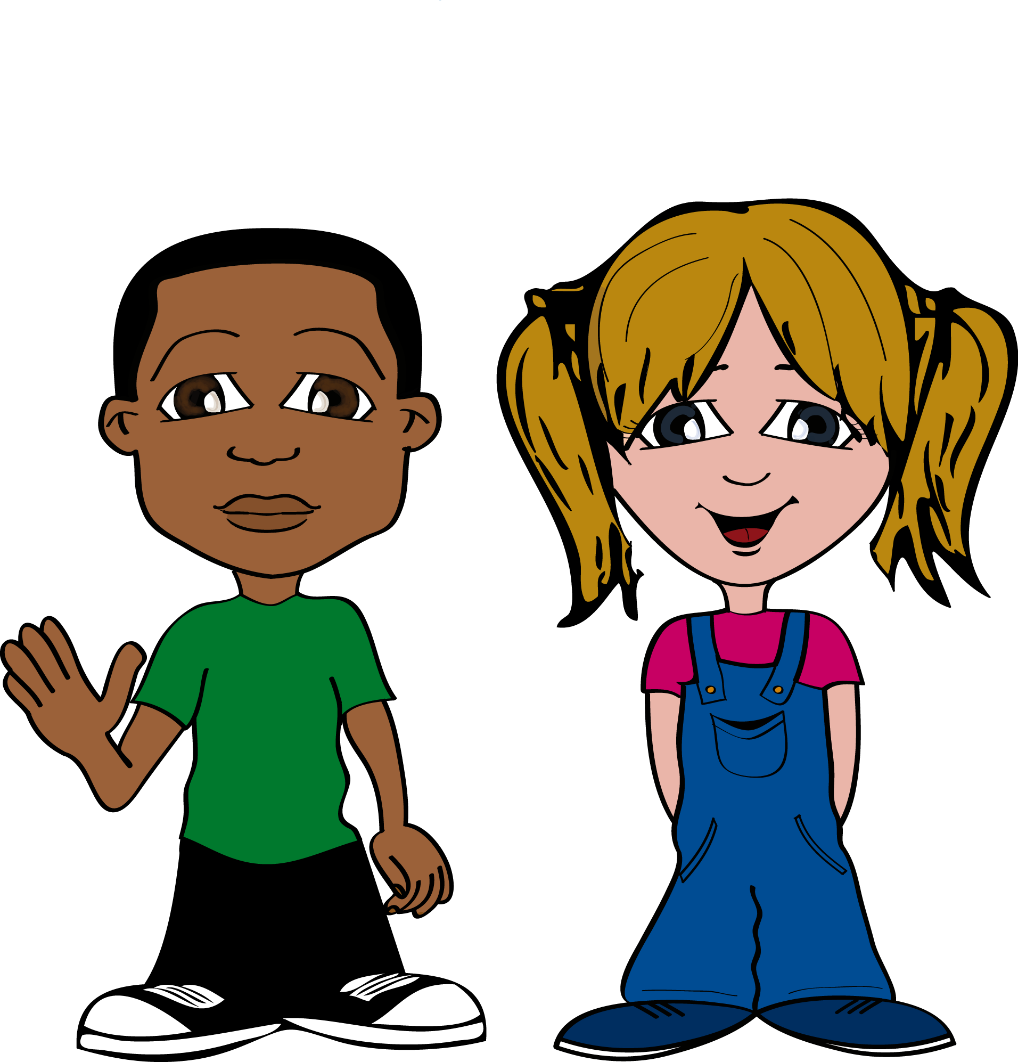
Max and Millie
A great day out
Notes:
A simple presentation designed to help children find out about healthy eating, five-a-day, the importance of hydration and exercise.

Slide 2
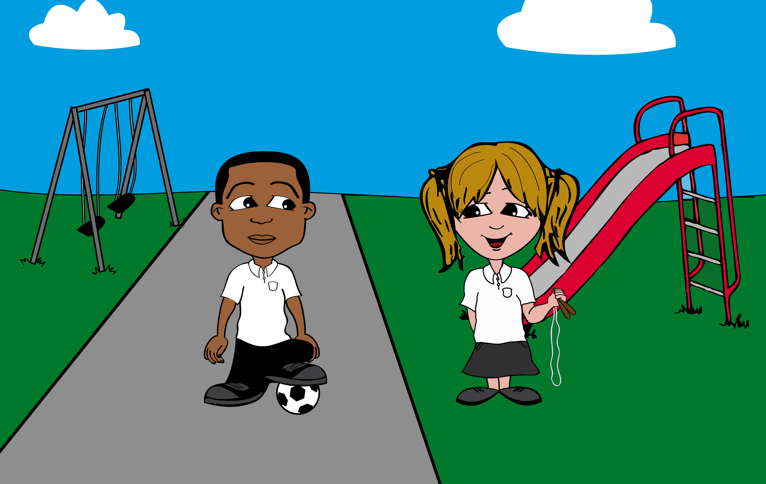
I’m looking forward
to our picnic tomorrow.
What shall we
take to eat?
This is Millie and her best friend Max, they are planning a picnic.

Slide 3
What about
lots of chocolate?
What about
lots of chocolate?
Do you think Max has made a good choice?

Slide 4
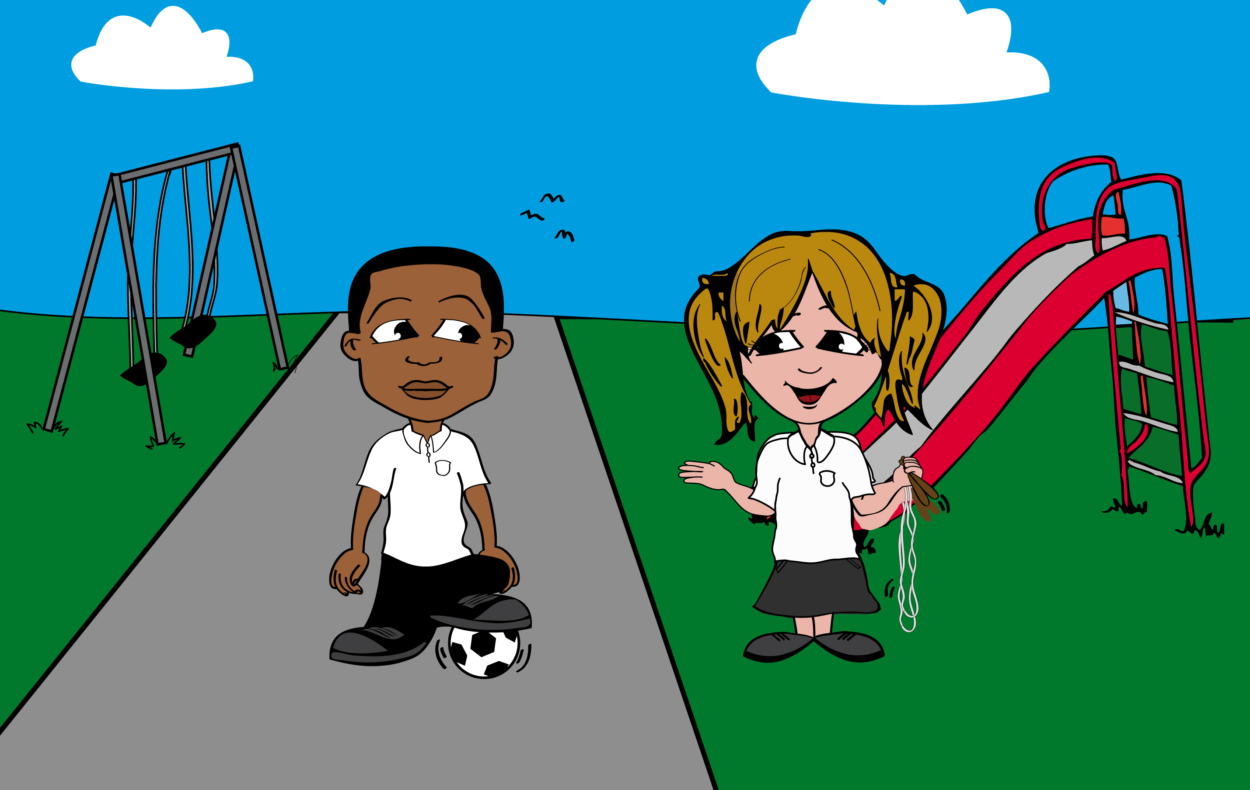
mmmmm…
Not very healthy…

Slide 5
OK, why don’t we
use the eatwell plate
to help us choose?
Do you know about the eatwell plate?
Notes:
Ask the children if they have seen the plate before?

Slide 6
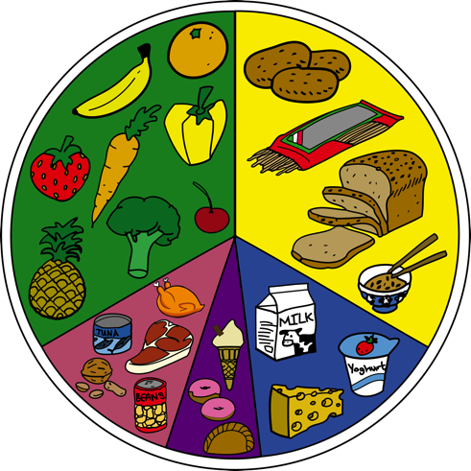
The eatwell plate
You can eat
lots of these!
You can eat
lots of these!
You can eat
some
of these!
And you should only
eat small amounts
of these!
You can eat
some
of these!
The eatwell plate makes healthy eating easier
Notes:
The eatwell plate highlights the different types of food that make up our diet, and shows the proportions we should eat them in to have a well balanced and healthy diet. The eatwell plate makes healthy eating easier to understand because we have a picture to look at.
Reference: NHS EatWell
http://www.nhs.uk/Livewell/Goodfood/Pages/eatwell-plate.aspx

Slide 7
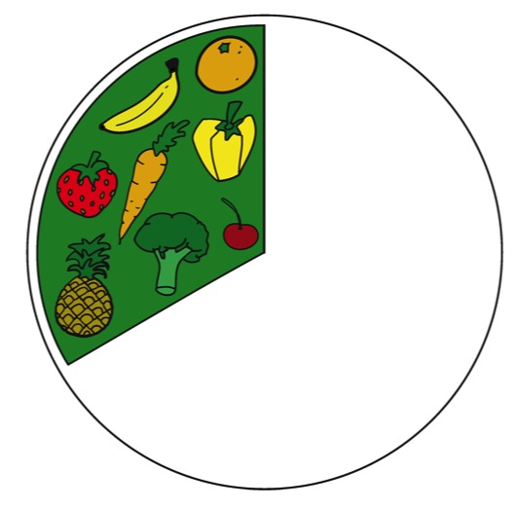
You can eat
lots of these!
Eat plenty of fruit and vegetables which are very good for you.
Notes:
Fruit and vegetables are part of a balanced diet and can help us stay healthy. That's why it's so important that we get enough of them.
For older pupils: It may be useful to mention percentages. 33% or 1/3 of our diet should be made up of fruit and vegetables. This is our total diet and does not relate to just one meal.
Reference: NHS EatWell
http://www.nhs.uk/Livewell/Goodfood/Pages/eatwell-plate.aspx

Slide 8
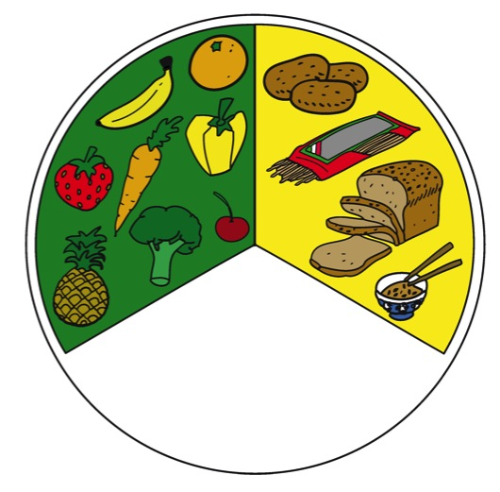
You can eat
lots of these!
Plenty of bread, rice, potatoes and pasta.
These give you lots of energy for exercise and activities.
Notes:
These are sometimes known as starchy foods are a good source of energy and important nutrients.
For older children: Bread and pasta etc. should make up about (33% or 1/3) of the types of food we eat each day
Reference: NHS EatWell
http://www.nhs.uk/Livewell/Goodfood/Pages/eatwell-plate.aspx

Slide 9
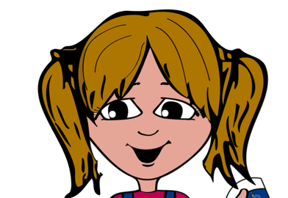
Yoghurt is
my favourite!
You can eat
some of these!
Milk and dairy foods are good for your growth and bones.
Notes:
Who can explain why we should eat some dairy foods?
Milk and dairy products, such as cheese and yoghurt, are great sources of protein and calcium.
For older children: Dairy should make up about 15% of the types of food we eat each day.
Reference: NHS EatWell
http://www.nhs.uk/Livewell/Goodfood/Pages/eatwell-plate.aspx

Slide 10
You can eat
some of these!
Some meat, fish, eggs, beans or nuts for protein.
Notes:
These are important sources of protein, vitamins and minerals.
For older children: Food in this section should make up about 12% of the food you eat daily
Reference: NHS EatWell
http://www.nhs.uk/Livewell/Goodfood/Pages/eatwell-plate.aspx

Slide 11
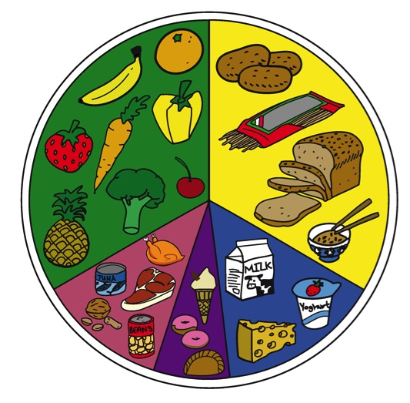
And you should only
eat small amounts
of these!
mmmmmmm!
And, only a small amount of sugary treats so that you keep your teeth and weight healthy.
Notes:
We all need some sugar and fat in our diets, but too much is not very good for us. It can be bad for our teeth and make it hard for us to concentrate.
Now we have a good idea of what foods we should eat and how much of them, I would like you to get into pairs and make a shopping list of the things you would like to take on a picnic. Remember, plenty of fruit and vegetables and plenty of bread, pasta, rice or potatoes. Some meat, nuts or beans and some dairy - and only a small amount of sugary treats. I’ll leave the Eatwell plate for you to look at while you are planning your picnic.
Hand-out the worksheets, which show the Eatwell plate and ask the children to make their lists with a healthy diet in mind.
Once the children have completed this exercise, take a look at Millie and Sam’s list.
Reference: NHS EatWell
http://www.nhs.uk/Livewell/Goodfood/Pages/eatwell-plate.aspx

Slide 12
The eatwell plate
You can eat
lots of these!
You can eat
lots of these!
You can eat
some of these!
And you should only
eat small amounts
of these!
You can eat
some
of these!
The eatwell plate makes healthy eating easier
Notes:
Leave this on the screen while the children make their picnic lists. When the children have completed their lists ask them to keep them as they will need them again later.
Reference: NHS EatWell
http://www.nhs.uk/Livewell/Goodfood/Pages/eatwell-plate.aspx

Slide 13
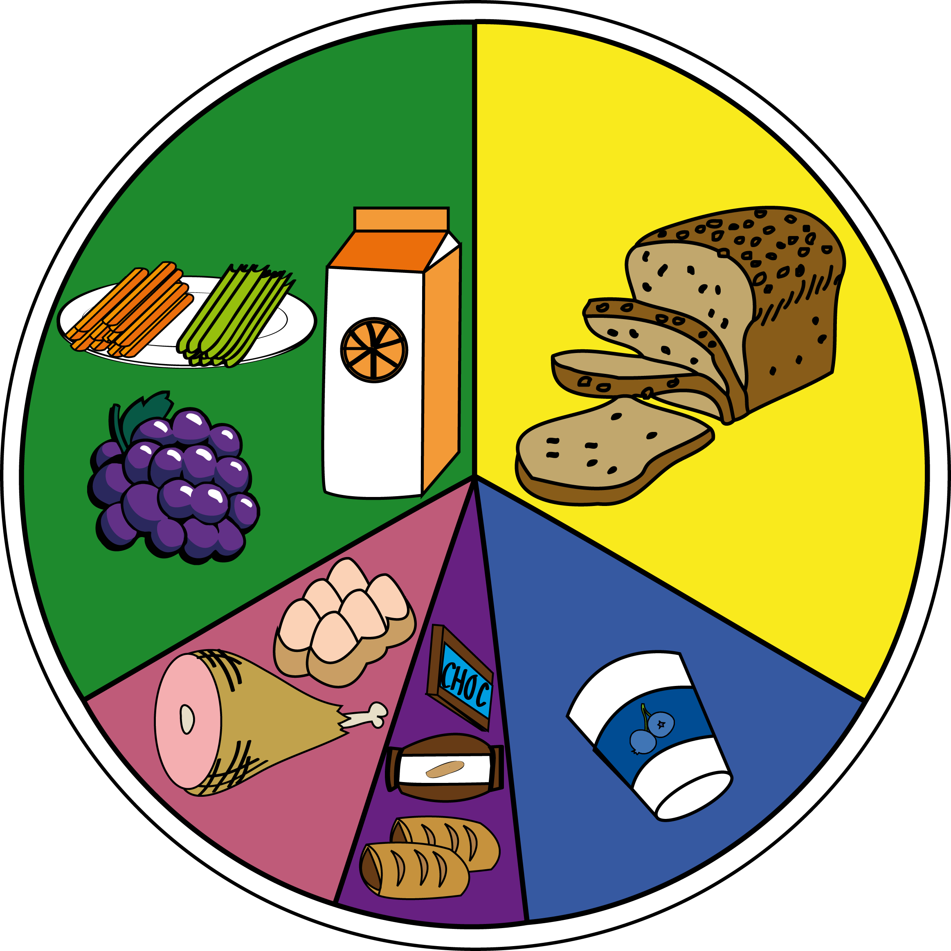
^{SHOPPING LIST:}
^{- Carrot and celery sticks}
^{- Hard boiled eggs}
^{- A loaf of bread}
^{- Sausage rolls}
^{- Ham}
^{- Grapes}
^{- Nuts}
^{- Orange juice}
^{- Yoghurt}
^{- A bar of chocolate}
Let’s check Millie and Max’s shopping list to see what they’ve chosen.
Notes:
Do you think Mille and Sam have made a good choice? Yes, because they have a balanced choice with something from each section of the plate.
Although Sam and Millie have chosen something from each section of the plate for their picnic, sometimes meals won’t have everything from each section. This is fine, as long as there are choices from each section throughout the day.
Now ask the children to go back to their work sheets and write down or draw the food they have chosen for their picnic in the correct section of the Eatwell plate. Hands up who thinks they have made a good choice?
(This is a good place to break if you want to split the learning across several sessions.)
Let’s say goodbye to Max and Miilie for today and we will join them again for their picnic.

Slide 14
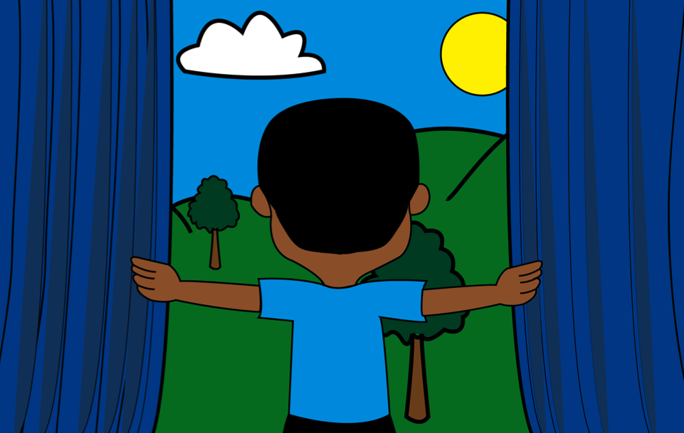
Look outside, it’s a
perfect day for
a picnic!
Saturday is here, the sun is shining and it’s picnic time!

Slide 15
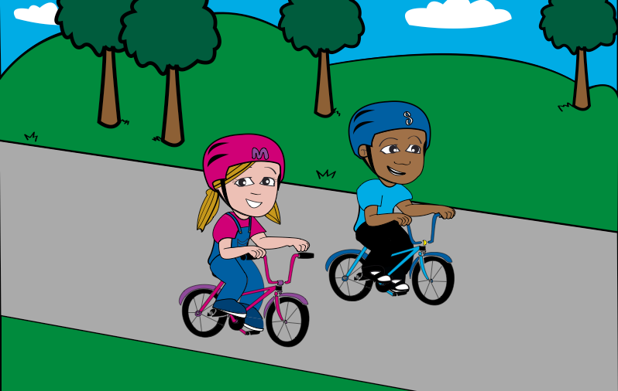
Max, Millie and Millie’s mum set off on their bikes. They’re cycling because it’s fun, good for them and good for the planet.
Notes:
Ask the children to think of three reasons why it’s good for them or the environment.
Prompts – good exercise, fresh air, no pollution

Slide 16
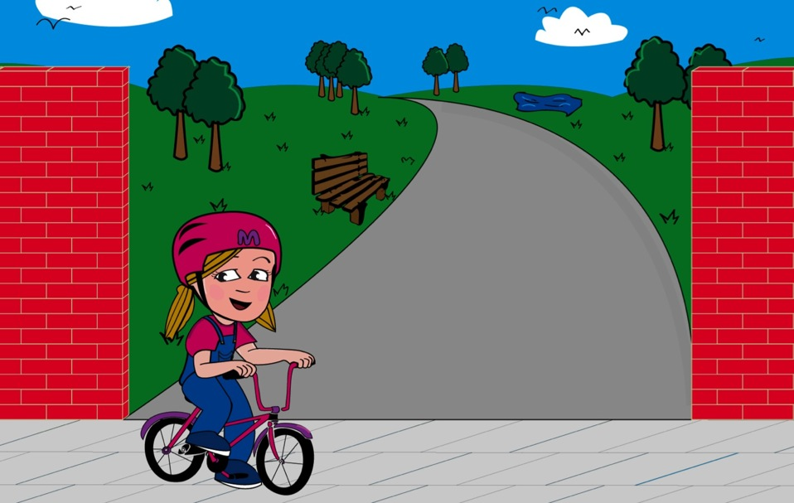
Keep up you two!
After a fun bike ride, they arrive at the park. They look for a spot in the shade where it’s nice and cool.
Notes:
Why might they look for somewhere that is cool?
Prompts: to avoid heatstroke, so their food doesn’t melt, to keep their drinks cool

Slide 17
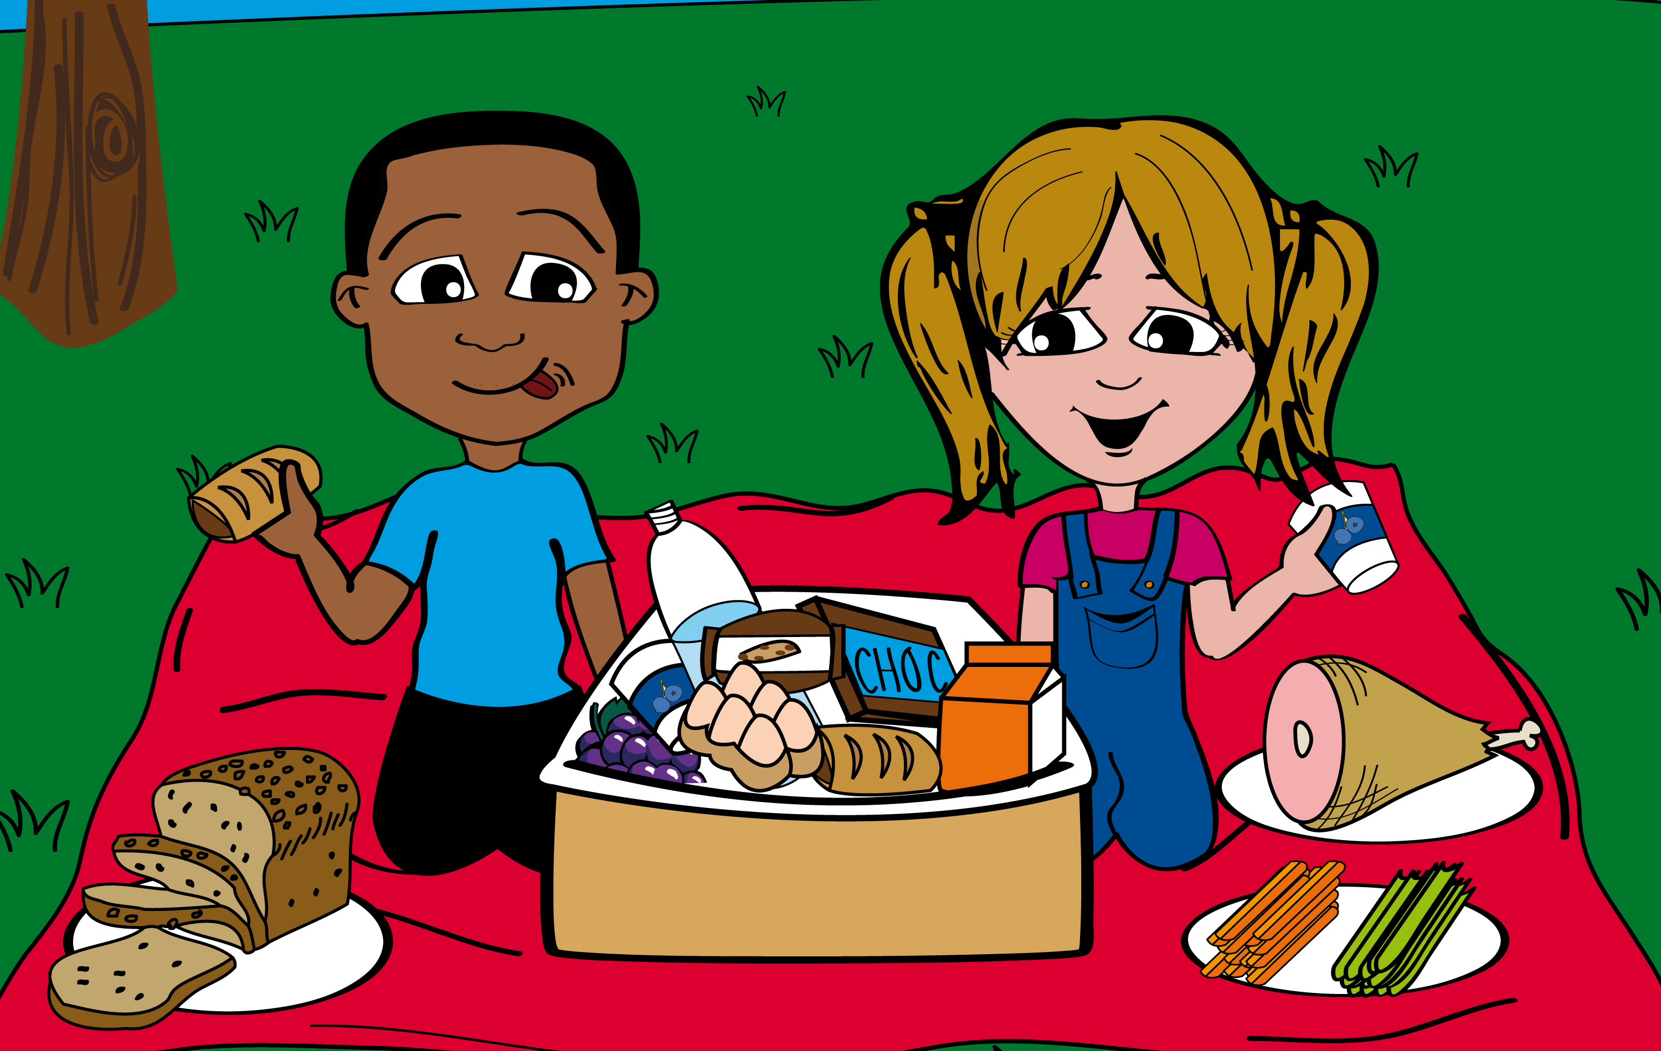
They are all very hungry, so they decide to eat right away.
Notes:
We know that Max and Millie’s picnic has food from all the sections of the Eatwell plate but what fruit and vegetables can you see?
Ask the children to call them out and write them up on the board.
Carrots, celery, grapes, fruit juice. How many is that? Four.
Do you know how many portions of fruit and vegetables we should try to eat every day? We should all try to have at least five but they can be spread across the whole day. So we might have fruit juice for breakfast or maybe a banana. We could have an apple at breaktime or lunch. We could eat some salad at lunchtime. Or we may have some tomatoes in the sauce of our spaghetti bolognese. Some beans on toast.
We are now going to work together to think about our favourite fruit and vegetables.
Now get the children to work through the 5-a-day worksheet and design a poster.

Slide 18
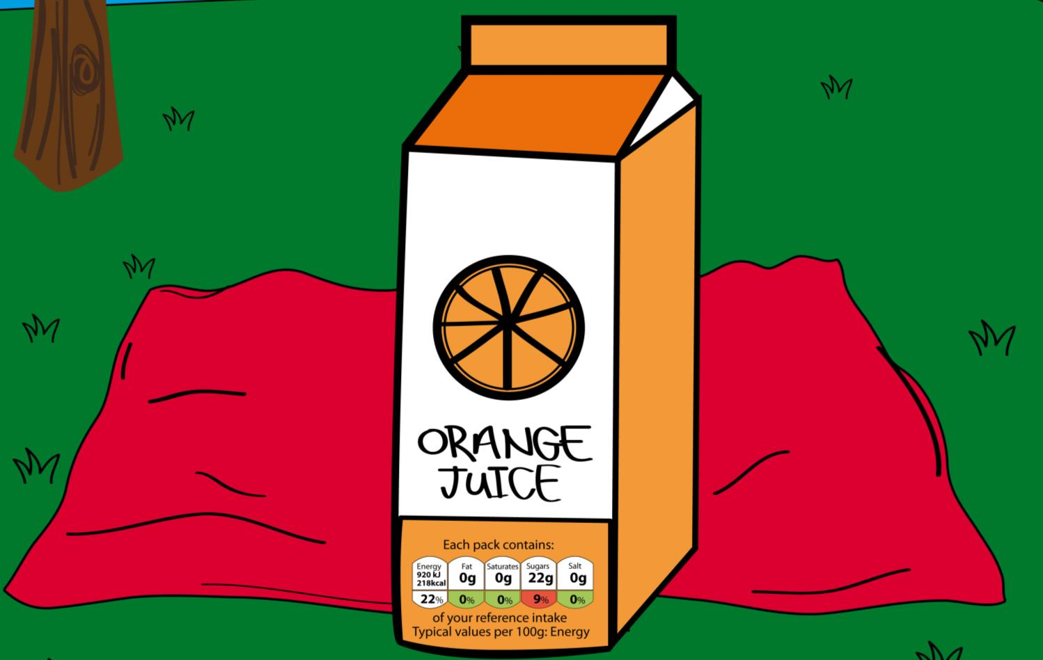
Millie spots a label on the front of the juice carton.
Notes:
18
Millie spots a symbol on the front of her juice carton. She want’s to find out what it means.

Slide 19
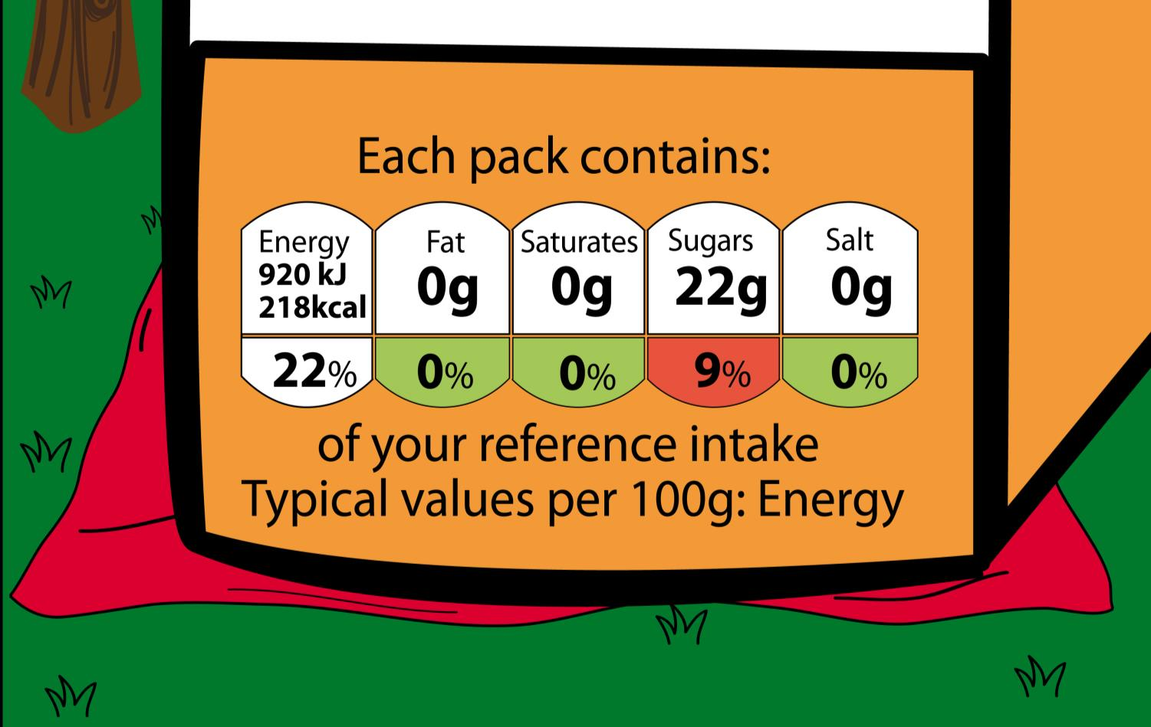
They check the label to see what’s inside.
Notes:
Hands up who recognises the diagram? What do you think it means?
Walk through the basic traffic light system
The symbols highlight what’s in the package.
Red – Red on the front of pack does not mean that you should not or cannot eat or drink this product, but that you should try to keep an eye on how often you choose them, or how much you consume. A diet with fewer reds can help you achieve a healthier diet.
Amber – This means the product is neither high nor low for that nutrient. They can help you balance your diet but just try to include a few green ones too.
Green – Products with green icons means the food or drink is low in that nutrient. The more green lights the healthier the choice but you should not just eat green foods however as you need a balance with a few ambers and reds to make sure you are eating all the nutrients required for a balanced diet.
This is a good place to break the presentation if you want to split the content into separate sessions.

Slide 20
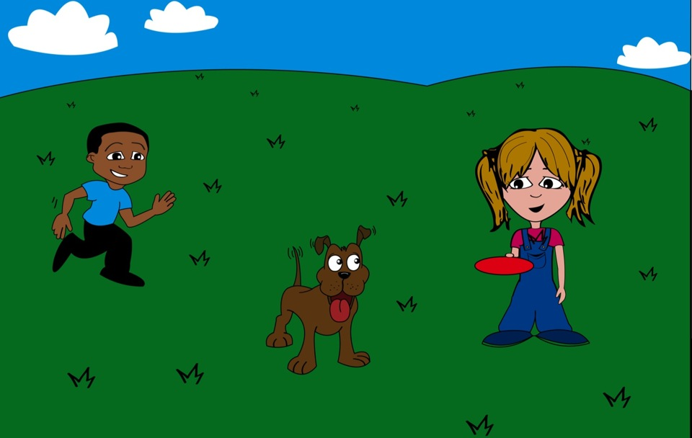
After a good, balanced picnic lunch, Max and Millie start to play.

Slide 21
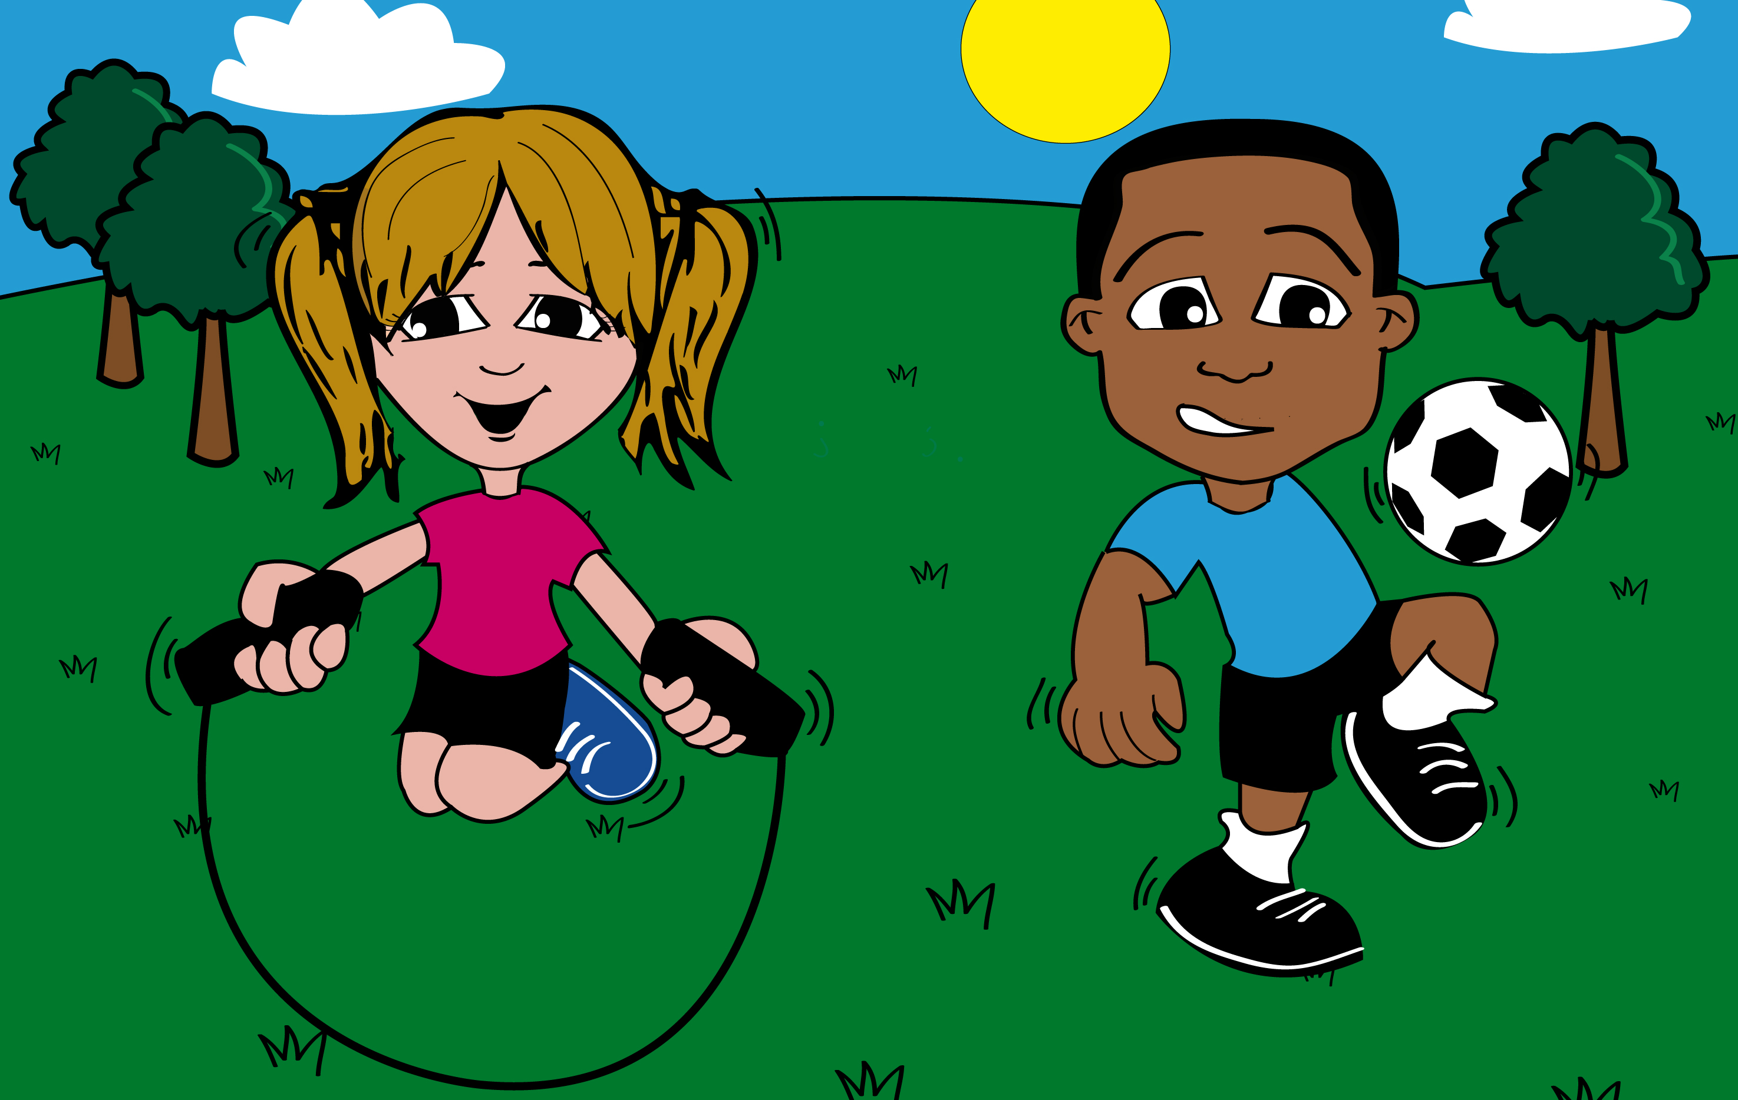
Max and Millie love to stay active.
Notes:
Get the children to draw a picture of themselves doing their active play activity.
If you have time discuss some of the reasons why active play is good:
Helps us to stay fit and healthy
Helps us to build strong muscles and bone
It’s very good for hand-eye coordination
It reduces the risk of illness
It helps you to maintain a healthy heart
It helps us to sleep more comfortably
It helps us to concentrate harder in class
It is a great way of reducing stress levels and lifting your mood when you’re down
It’s a great way of meeting new friends
Remind children that by making more time for exercise they will feel livelier and have more energy. Try to have at least 30 minutes of exercise a day.
Reference: Change4life
http://www.nhs.uk/change4life/Pages/get-going-every-day.aspx

Slide 22
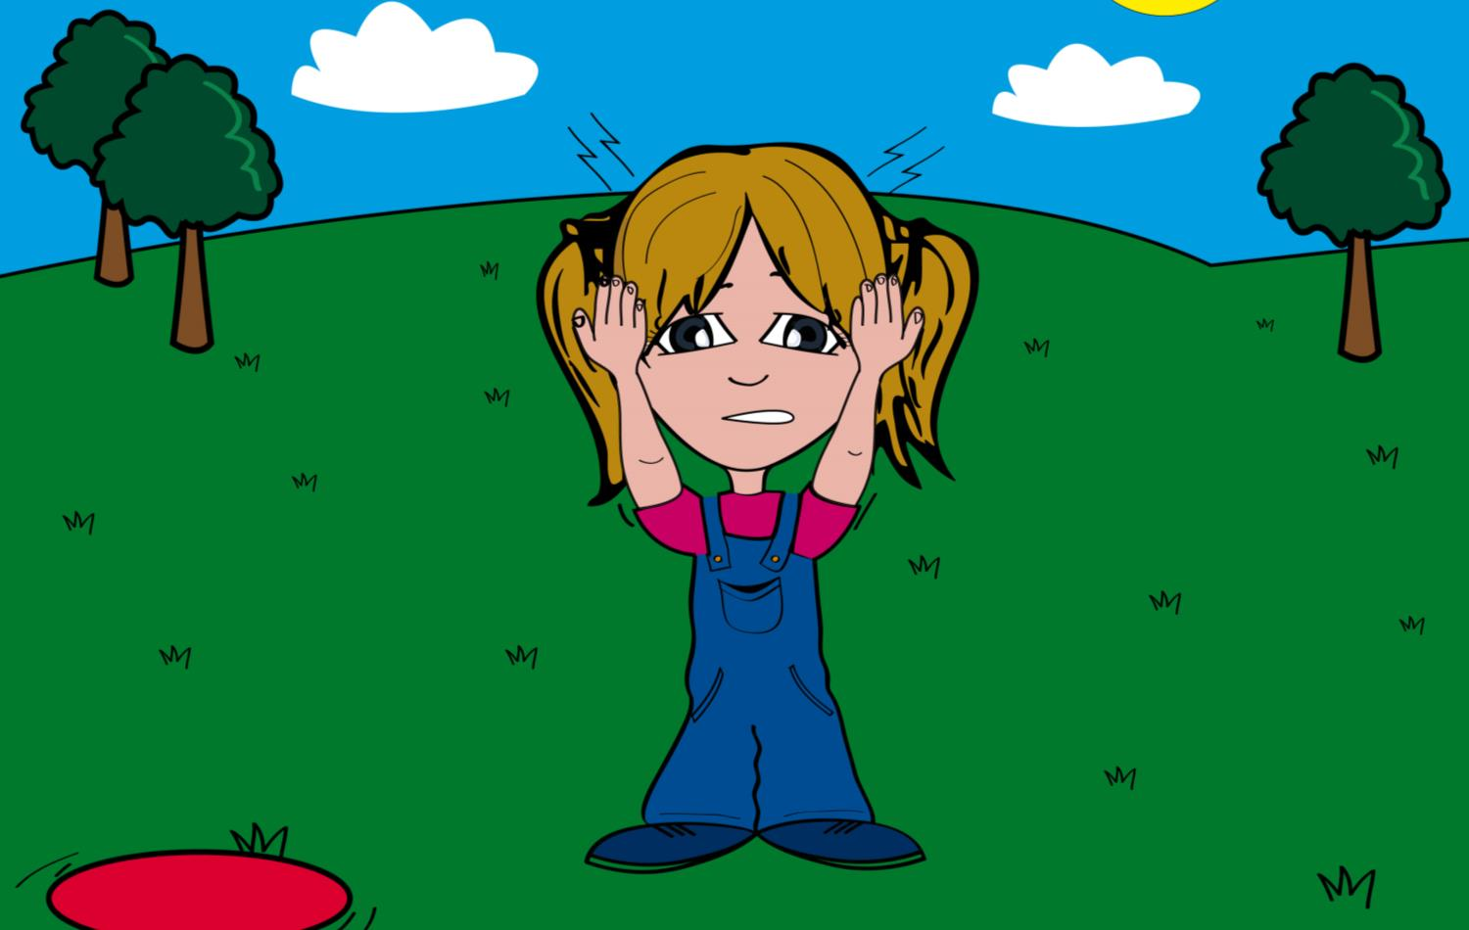
Millie starts to feel dizzy and her head starts to ache. They run back to their picnic spot to find her mum.
Notes:
After 45 minutes of playing in the hot sun, Millie starts to feel dizzy and her head starts to ache. They run back to their picnic spot to find her mum.

Slide 23
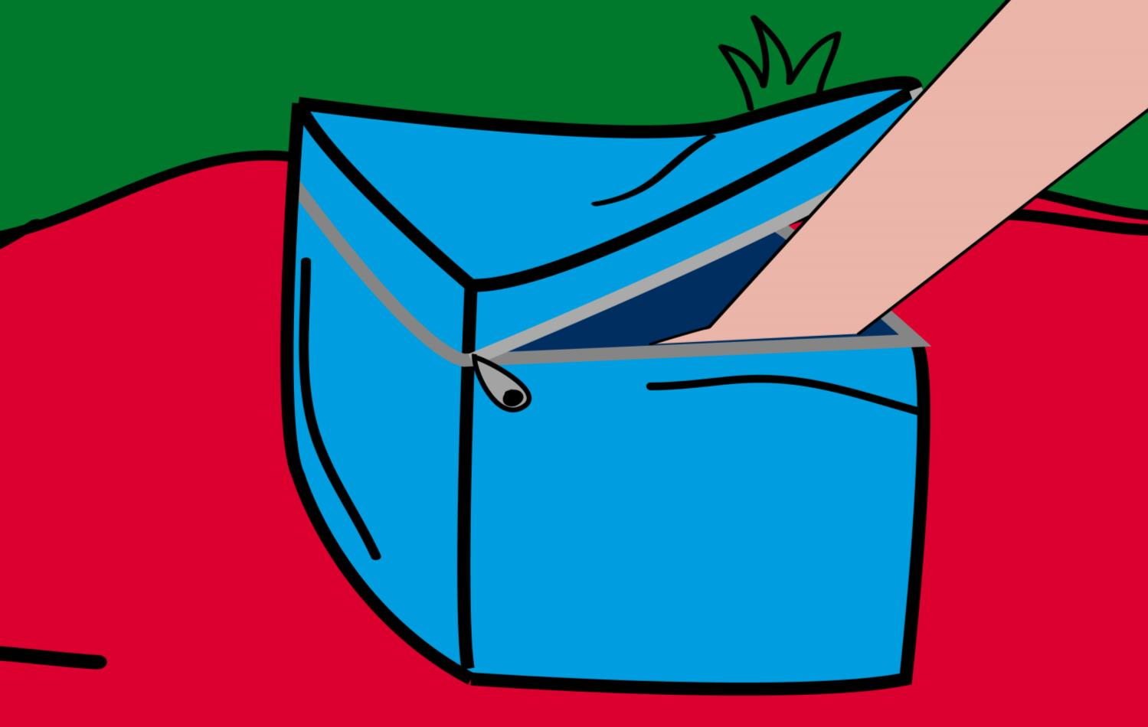
Millie’s mum knows what’s wrong straight away, she reaches into their cooler bag…

Slide 24
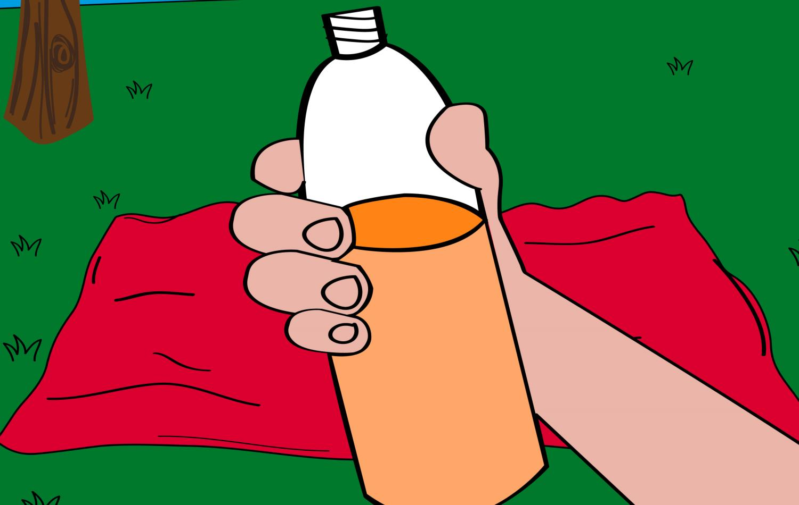
Millie is feeling thirsty and may be dehydrated, which means she hasn’t drunk enough.
Notes:
Our bodies lose water very quickly, especially when we’re exercising or when it’s warm.
We must drink water to replace the water our body loses.
Hands up who can tell me how we lose water from our bodies?
Sweat
What may cause us to sweat more?
> Exercise
> Heat
> Nerves
> Some spicy food
Urinating
> This is our way of getting rid of waste unwanted nutrients in our body.
Breathing
> We breath out tiny water particles continuously. Try breathing on a window one day and see for yourself.
Reference: NHS
http://www.nhs.uk/Conditions/Dehydration/Pages/Causes.aspx

Slide 25
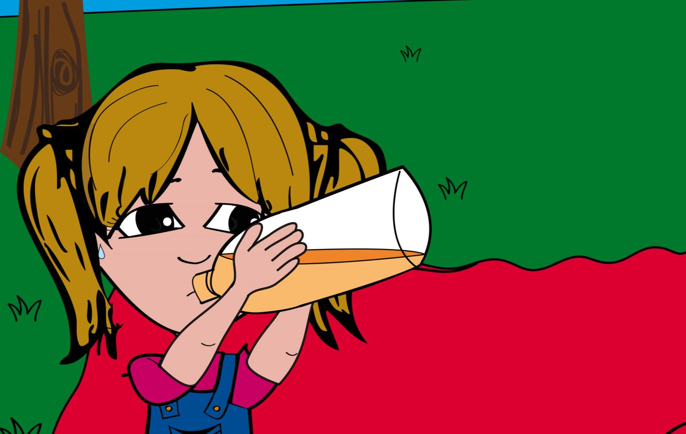
Millie has a drink and soon starts to feel much better.
Notes:
Millie is drinking squash.

Slide 26
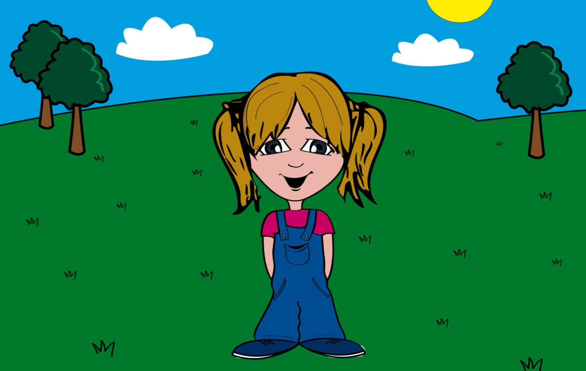
Dizziness
Headaches
Tiredness and low concentration
Rapid heartbeat
Dark coloured wee
Our bodies can tell us when we are not drinking enough.
Notes:
It’s very important to pay attention to our bodies, especially when exercising in hot weather, because they can tell us when we’re not drinking enough.

Slide 27
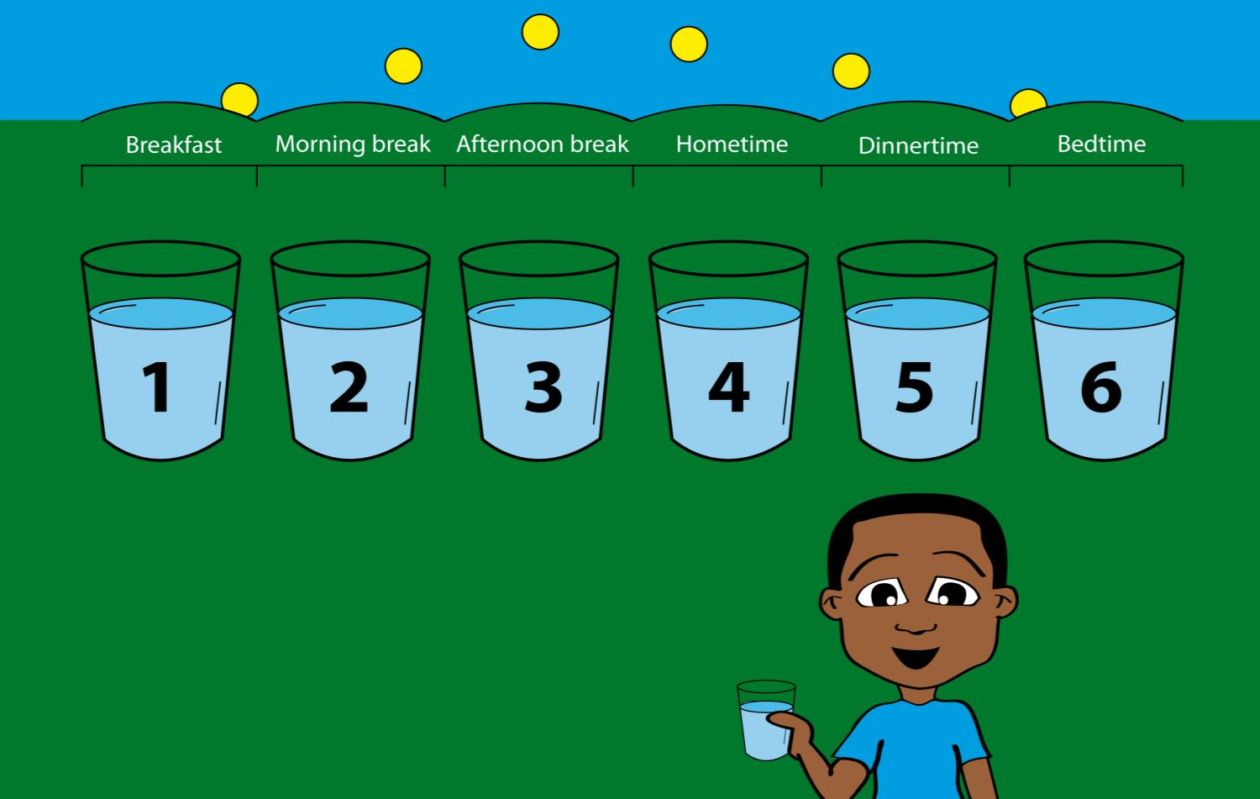
I use my school timetable to help me!
The average 4-8 year old should drink at least 6 cups of liquids per day.
Notes:
The average 4-8 year old should drink at least 6 cups (200ml) of liquids per day. It sounds like a lot, but remember that’s over 12 hours.
Reference: National Hydration Council

Slide 28
This chart can help us check if we are drinking enough.
Notes:
When we visit the loo we can take a look at the colour of our urine. The lighter the colour the better hydrated you are. If your urine looks dark yellow like those bars at the bottom of the chart you definitely need to dink more liquids.

Slide 29
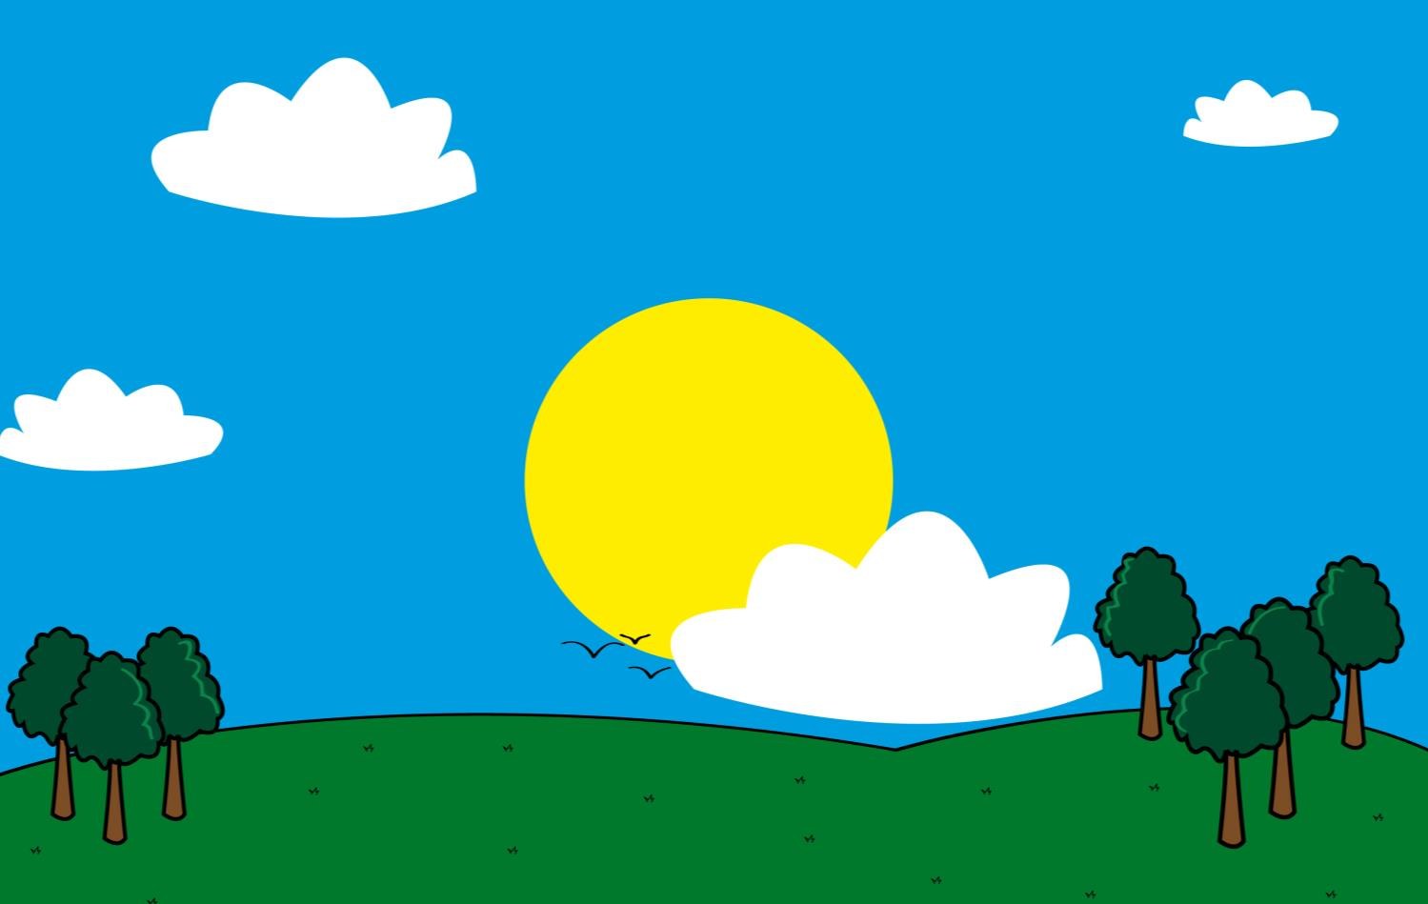
Looks like the sun’s starting to go down, time to go home!

Slide 30
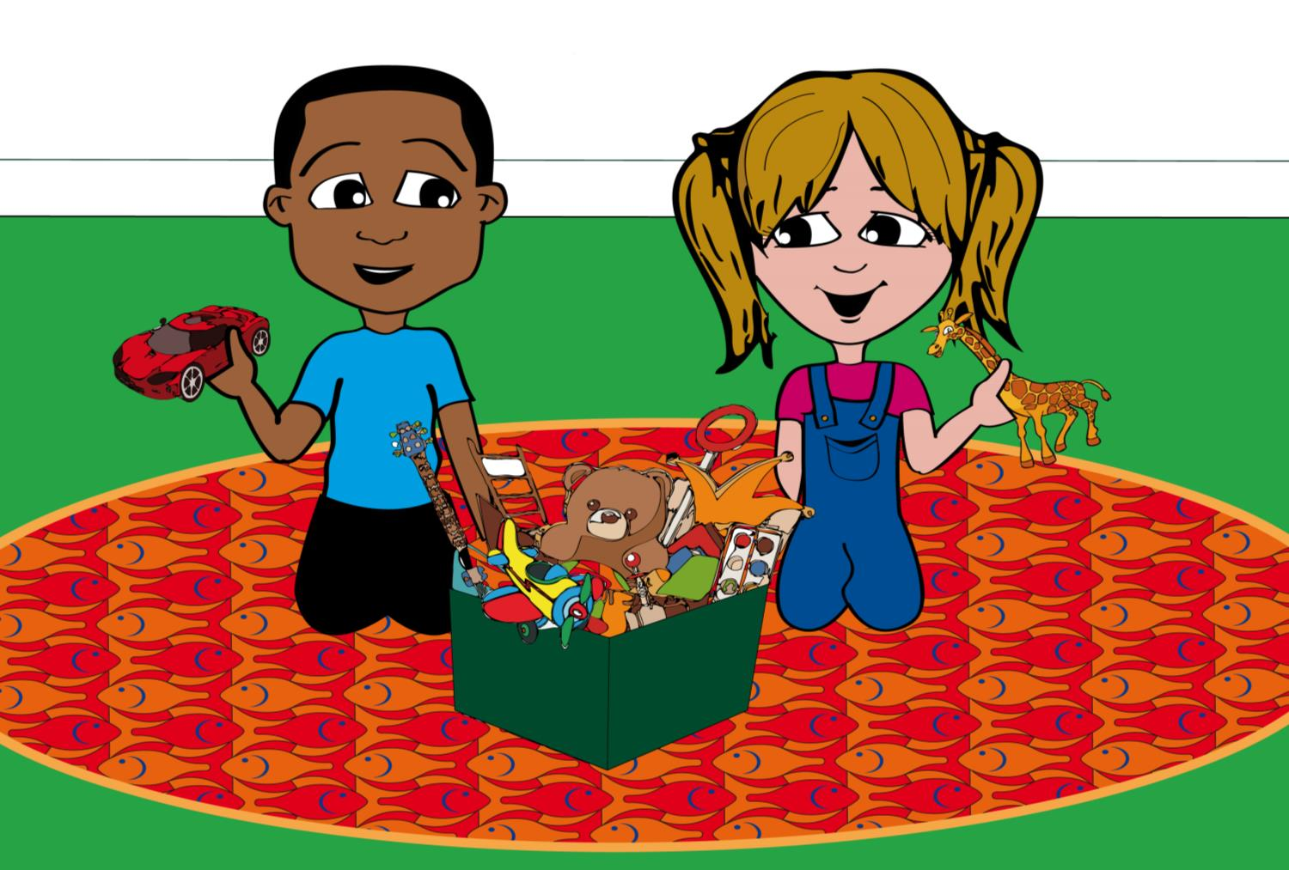
After arriving home, Millie’s mum starts to make dinner.

Slide 31
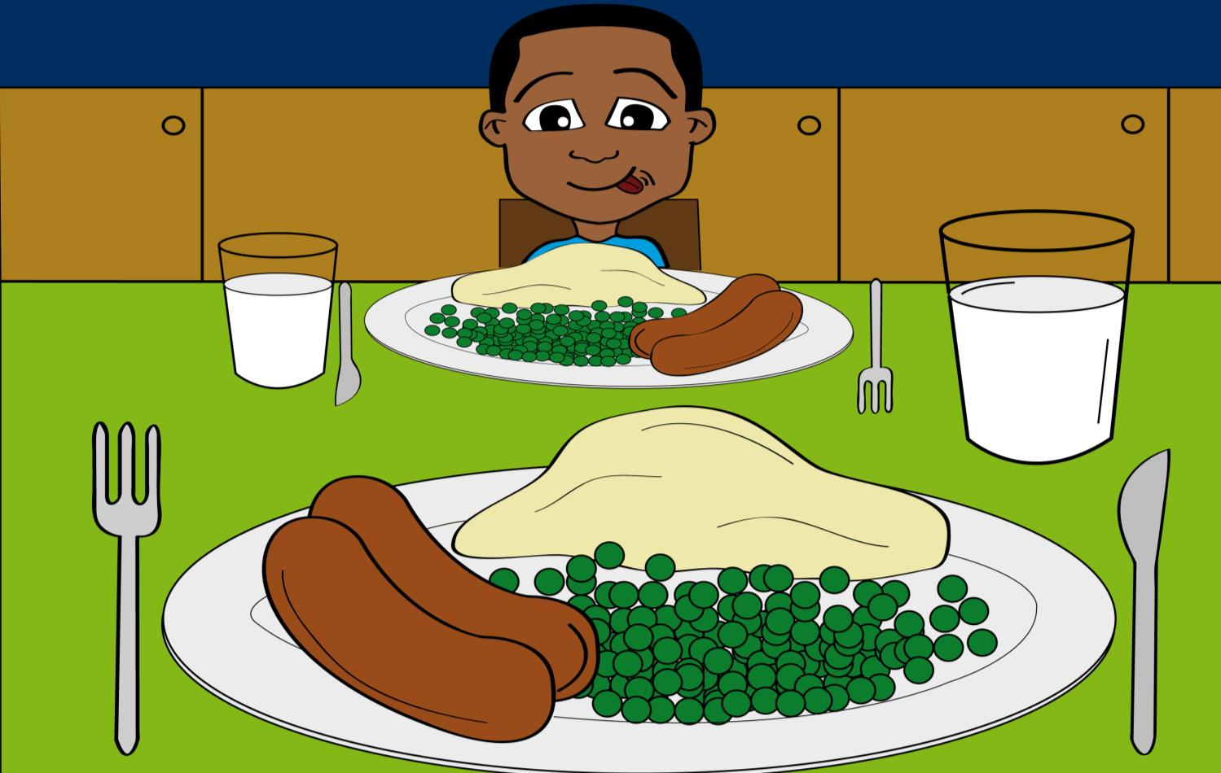
She cooks them sausages, mashed potatoes and peas with a glass of milk.
Notes:
After an active day Max and Millie need to restore their energy with a balanced meal. Ask the chlidren to write down what section of the Eatwell plate each item belongs.

Slide 32
We hope to
see you
again soon!
Thanks for
joining us on our
big day out!
Both tired after a long day, Max and Millie go to bed to get some rest so they’ll be ready for a new day tomorrow.

